Slide 1
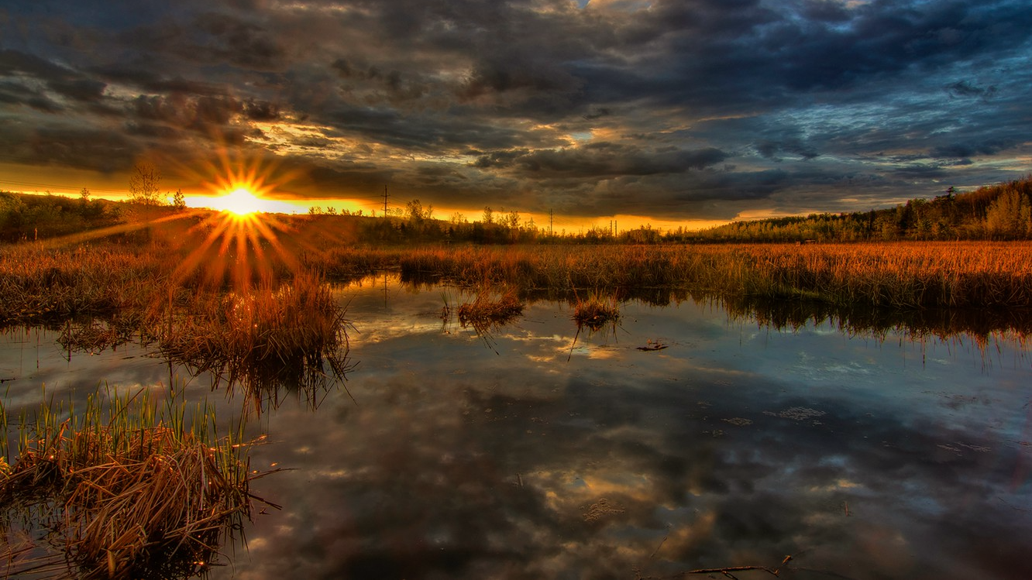
Summer Meeting with Lab Leads Mack White
22 June 2022

Slide 2
1.) Spatial Similarity Paper 2.) ForEverglades Scholarship 3.) IACUC Modifications

Slide 3
SPATIAL SIMILARITY PAPER
TO-DO LIST:
1.) Read Zaccarelli et al 2013 – “RInSp: an R package for the analysis of individual specialization in resource use”
2.) Make a table of all isotope values we currently have (months and years)
Criteria
- Common Snook
- Shark River
- Sulfur Values
- Date Included
3.) Try to hunt down E-value code in Google Drive

Slide 4
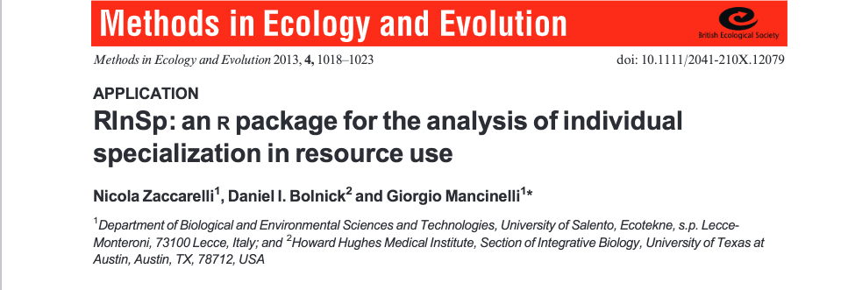
SPATIAL SIMILARITY PAPER - readings

Slide 5
SPATIAL SIMILARITY PAPER – table with isotope values
Criteria:
Common Snook
Shark River
Sulfur Values
Date Included
Things to note:
19 samples from FCE Food Webs 2019 that had no date association
Removed 81 samples from CELA project
Removed 8 samples from CESI project
Removed 17 offshore snook on East Coast
Removed 17 offshore snook on West Coast
Removed 2 samples that had no spatial information, but possibly Shark River?

Slide 6
SPATIAL SIMILARITY PAPER – hunting down R code/other R things
Found hydrology R code (z score M-0215 stage data; author Nat Viadero)
Could not find code with E-value generation
Started to mess around with median monthly stage data and think about incorporation of isotopes/hypotheses
Changes in individual niche volume between wet/dry
Changes in individual niche overlap between wet/dry

Slide 7
